Slide 1
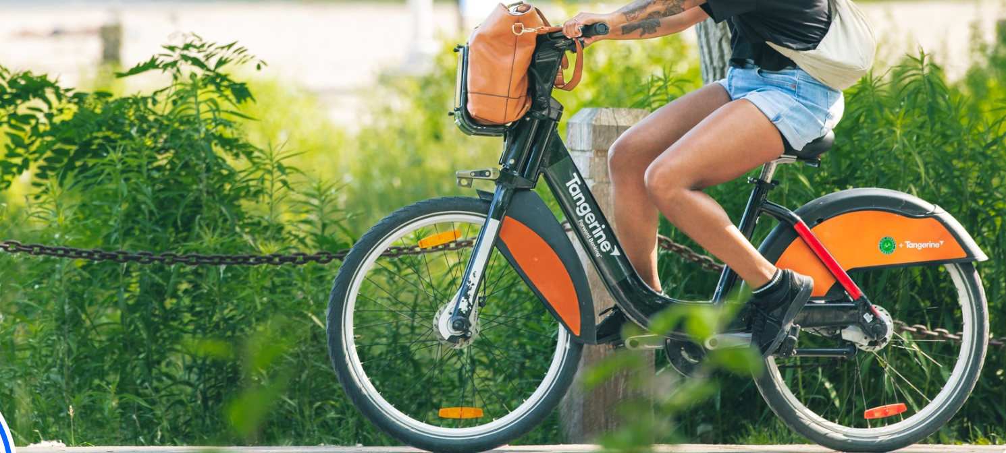

BIKE SHARE TORONTO RIDERSHIP GROWTH OPTIMIZATION
InsightOps
01

Slide 2

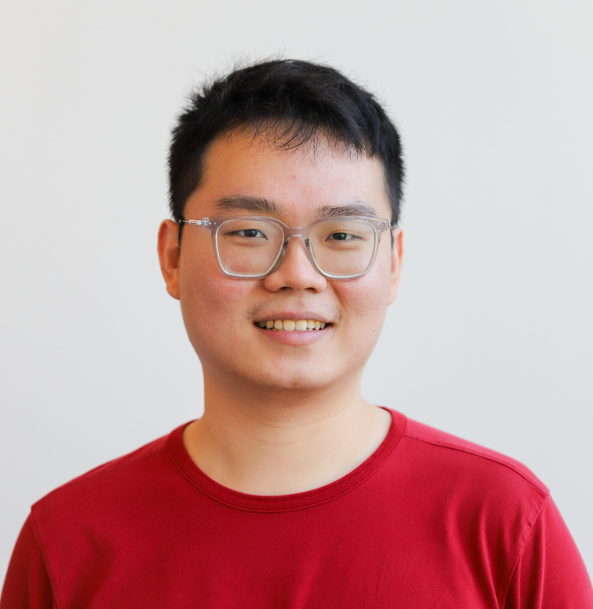


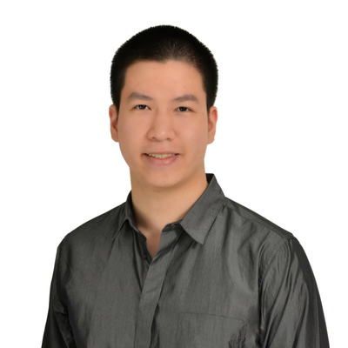
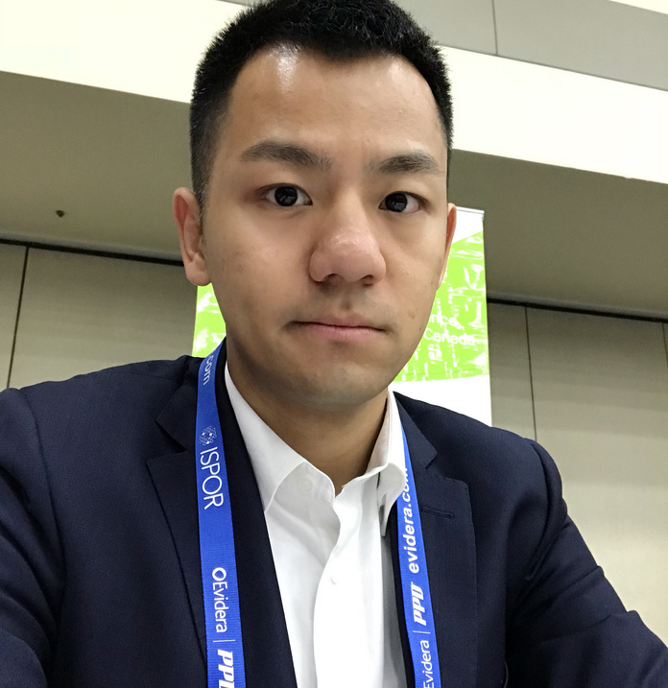


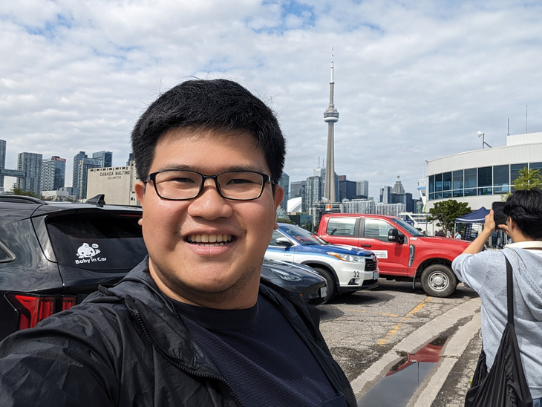
Meet Our Team
Dai Vinh Quach
(Project Team Lead)
Tenzin Yangzom
(Administrator)
Chawin Hong
(Market Researcher)
Krishna
(BI Developer)
Adora Montminy
Wenrui Shan
(Data Analyst)
Tianyu Ge
(Data Analyst)
Thi Thu Hien Nguyen
(Business Analyst)
Joshua Nalundasan
(Account Executive)

Slide 3

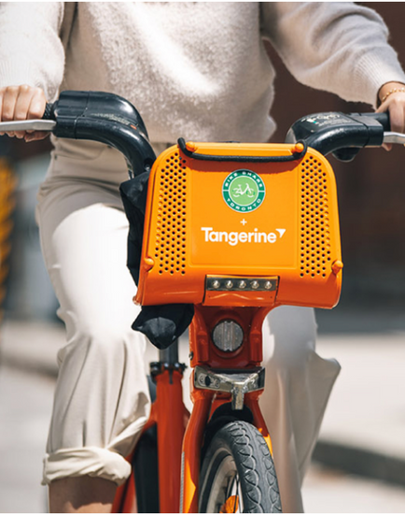
Content
Introduction
Problems statement and objectives
Data Introduction
Timeline
Methodology
Insights
Recommendations
Challenges

Slide 4


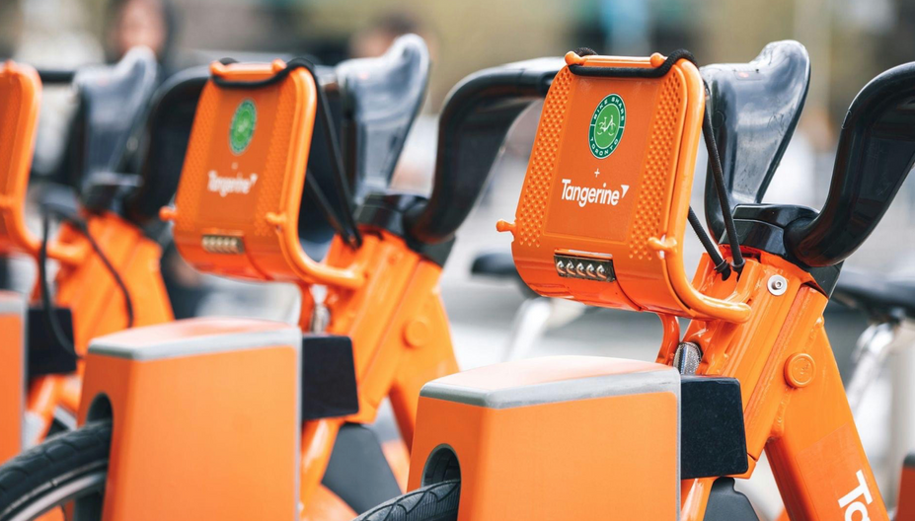


Introduction
Rapid Growth
Over 9,000 bikes, 8,00+ stations
Mission
Provide convenience, eco-friendly short trips
Development Highlight
4.6 million rides in 2023
80% increase since 2020

Slide 5
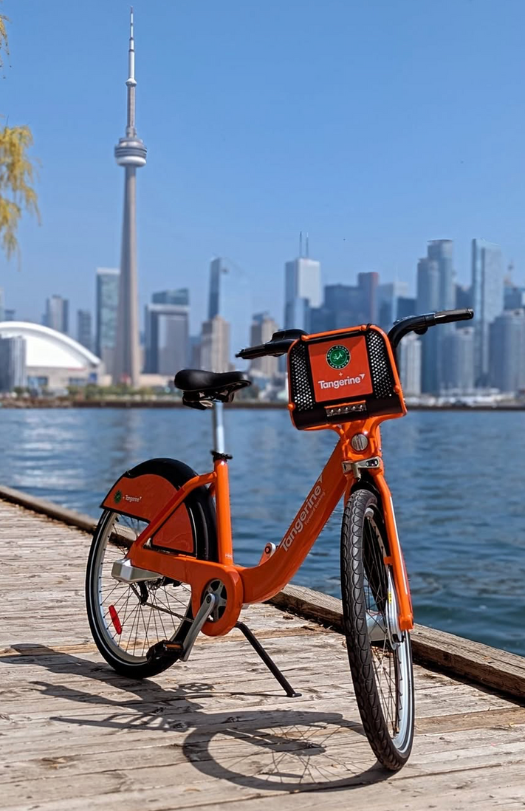
Problem Statement
Limited user behavior insights (commuting vs. leisure)
Geospatial mapping & infrastructure correlation challenges
No global benchmarking framework (Paris, New York)
Objectives
Visualize trends & demand hotspots
Assess service equity
Optimize station placement, pricing, marketing
Support urban expansion planning

Slide 6
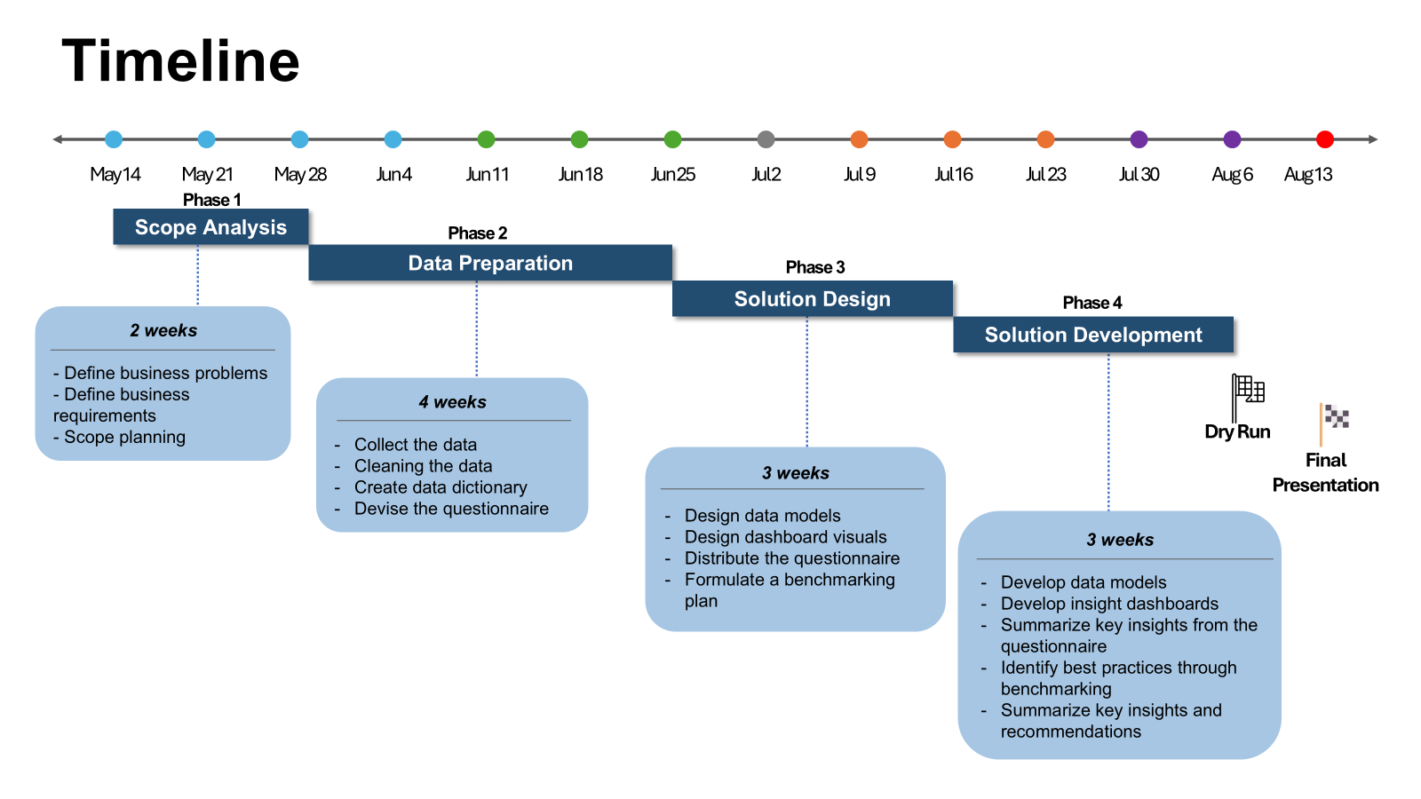

Slide 7
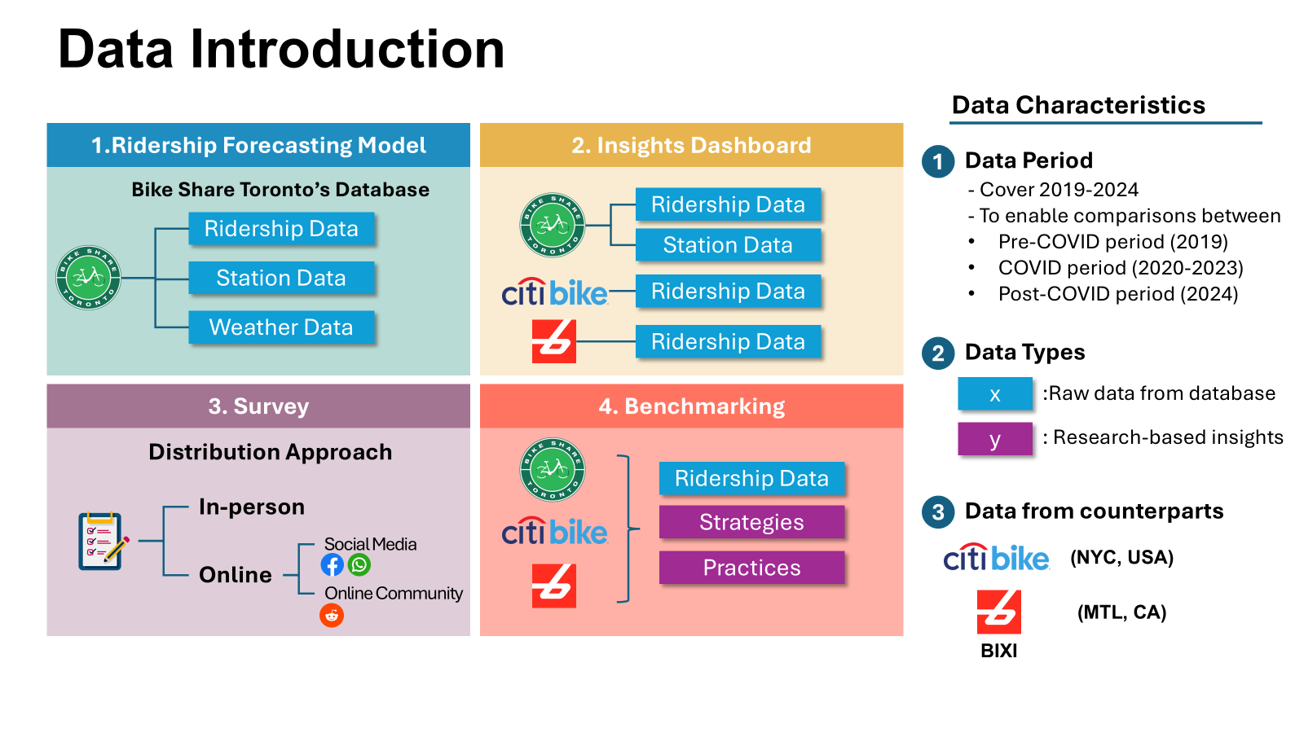

Slide 8
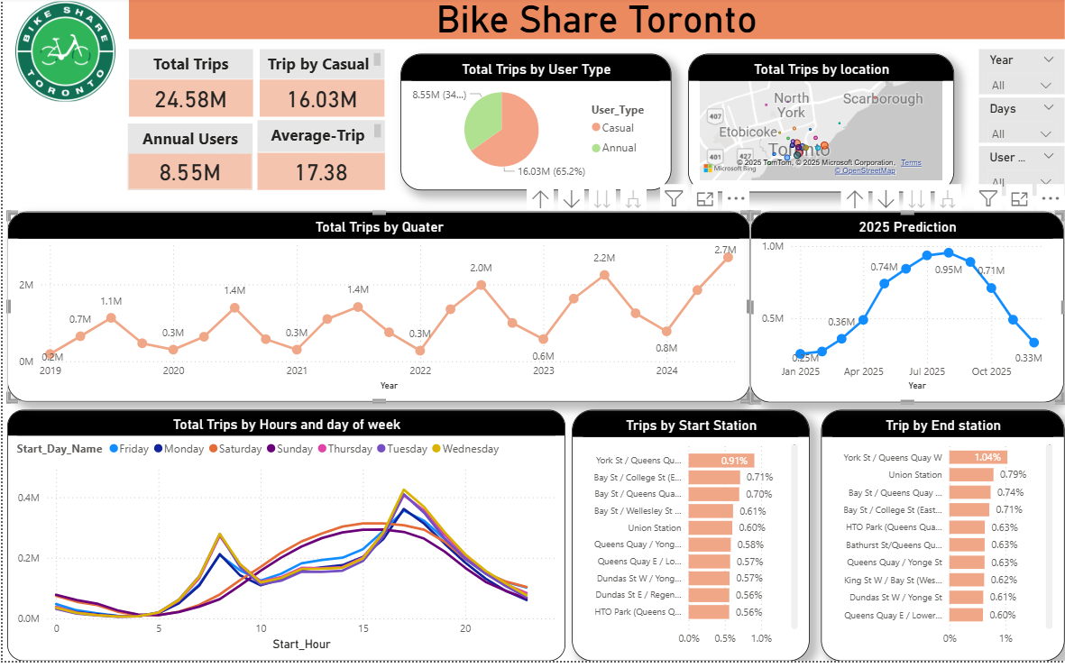

Slide 9
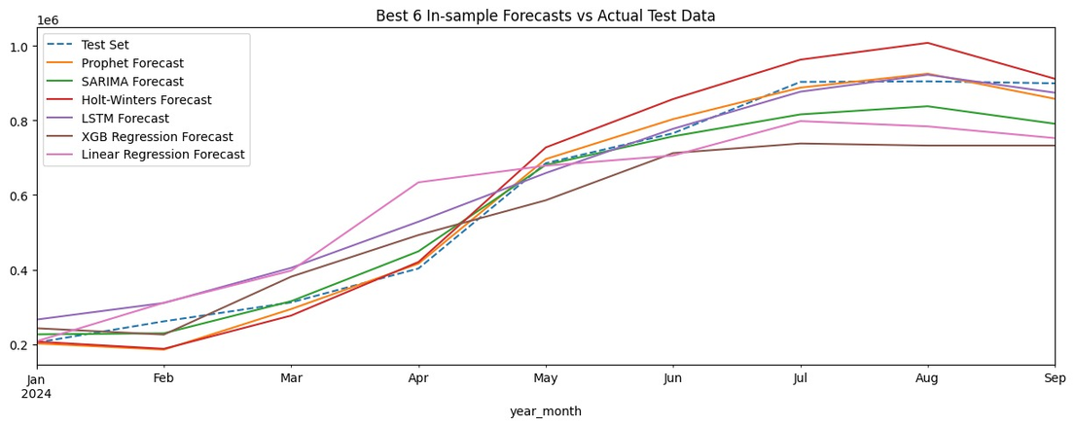
RIDERSHIP OPTIMIZATION
Ridership Data
Insight
Total Trips: 24.58 million trips, 933 locations
User type: 65% casual, 35% annual
Station Utilization: Centralized Activity
Location: Downtown area
User Demographics
Dominance of Casual Users → Users are tourists or those who use the service infrequently, rather than daily commuters
Trip Trends Over Time
Growth Trajectory: an upward trend, strong growth with a notable boost during the COVID-19 period, and Rides peak in the summer months of June to August..
Seasonal Fluctuations: peaks in the summer months (Q3) and drops significantly during the winter months (Q1)
Daily & Hourly Usage Patterns
Commuting Patterns: 8-9 AM in the morning and 4-6 PM in the late afternoon/early evening.
Weekend Usage (Sat and Sun) is different → weekend trips are more for leisure and recreation rather than commuting
Most Popular Stations
Centralized Activity: The majority of bike share activity is heavily concentrated in the downtown core of Toronto
Riders Forecasting
D

Slide 10
SURVEY IMPLEMENTATION
Questionaire
Insight
Demographics
What is your age group?
What is your gender?
What is your occupation?
User Experience & Preferences
In the last three months, how often do you use the bike share service from BST?
What is your overall sentiment regarding the safety, pricing and payment options for BST?
Suggestion & Feedback
Do you have any recommendations for new equipment?
Do you have any other suggestions or feedback to help us improve the BST?
Demographics
Mostly men (53.3%), young adults aged 25–34 (48%), and full-time workers (52.5%), indicating strong commuting potential
User Experience
23% have never used the service; only 6.2% ride daily. Most use it occasionally or a few times a week.
Customer Perception
85% find it convenient; 73% are satisfied. Neutral/dissatisfied users (25%) present an improvement opportunity
Improvements
Top requests: baskets/storage (33.8%), helmets (26.3%), lighting (22.2%). Most-wanted new offerings: scooters/e-bikes (38.9%) and more stations (29.3%).
⟶ Target non-users, upgrade equipment to boost retention, and diversify offerings to attract more frequent riders.

Slide 11
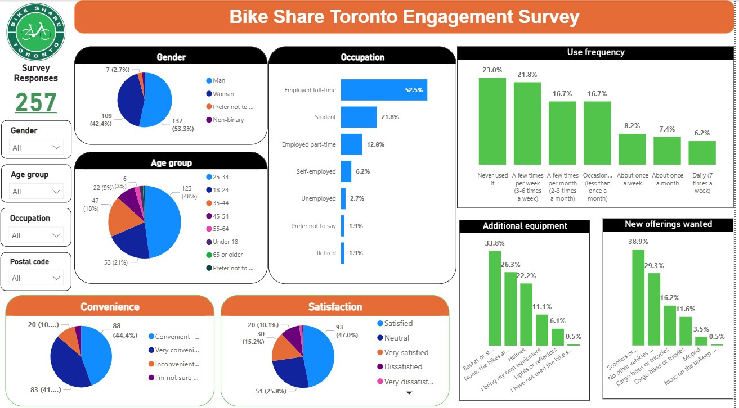

Slide 12
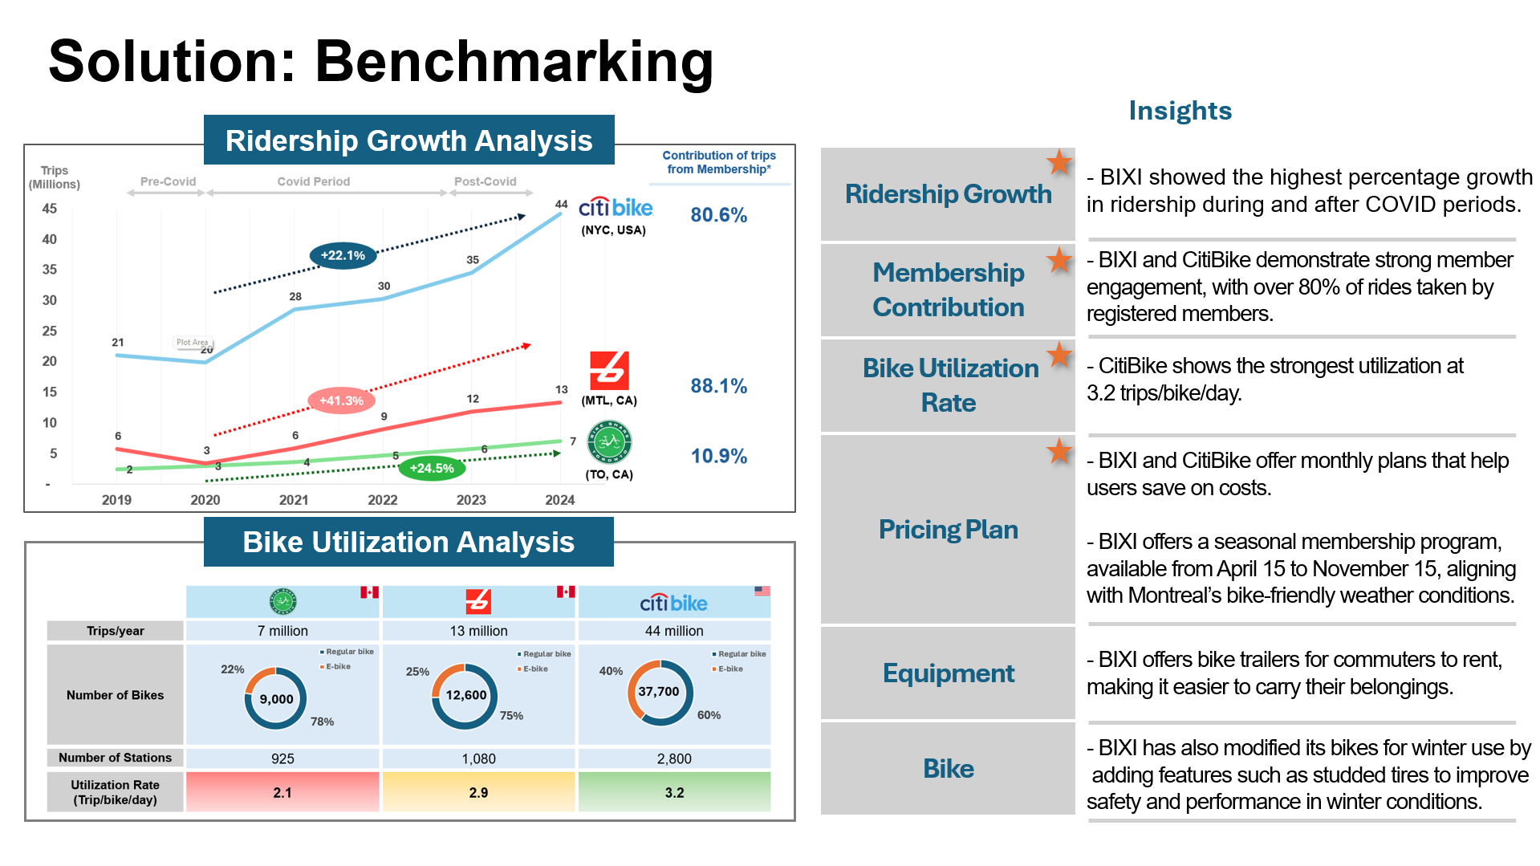

Slide 13
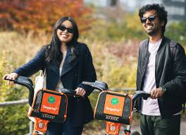
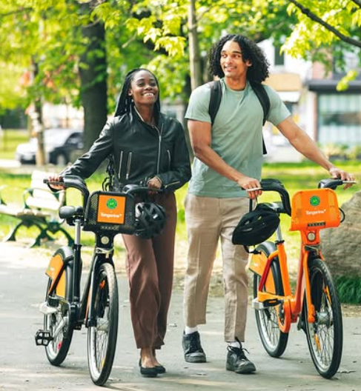
“WeBike2Gether”
Campaign Plan
🔧Issues tackled
Low User Acquisition & Engagement
Limited Awareness & Brand Visibility
Moderate Satisfaction & Unmet Feature Expectations
🕒 Duration: 3 Months
🎯 Campaign Goals
100.000 trips made during the campaign
30% → 60% users using a bike at least 2-3 times a week
11% → 40% contribution to trips from the memberships
45% → 80% users feel Bikeshare services are very satisfying and convenient
6.000 → 20.000 Followers in social media platforms.

Slide 14
“WeBike2Gether” Campaign Plan
📣 Key Campaign Components
1. Referral Program
$20 Gift Card for Both Sides – Reward both referrer and referee to ride bike together.
Milestone Rewards – Bonus ride credits or free month memberships when a user reaches 3, 5, or 10 referrals.
2. Influencer Partnerships
200 sustainability, health, lifestyle influencers (5K–200K followers) with reels, ride-alongs, hashtag campaigns
Influencers share exclusive codes linked to the referral program to track conversions.
3. Social Engagement
User-Generated Content Contests – Best ride photo or scenic route wins a free membership month.
Quick Polls & Stories – Ask users about favorite routes, most used stations, or desired features.
Share posts with hastags: #WeBike2gether#BikeShareTO
4. Community Pop-Ups
Weekend events in high-traffic areas like Nathan Phillips Square, Eaton Center, UofT downtown campus
Free trials, live demos, safety tips
Local vendor partnerships, local biking communities

Slide 15
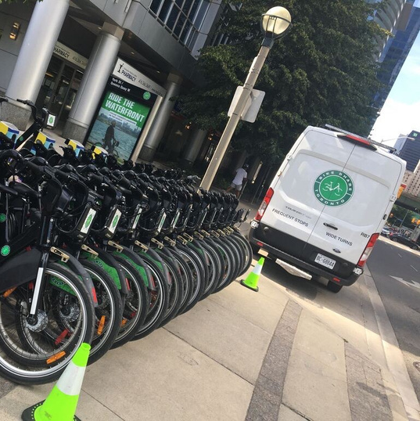
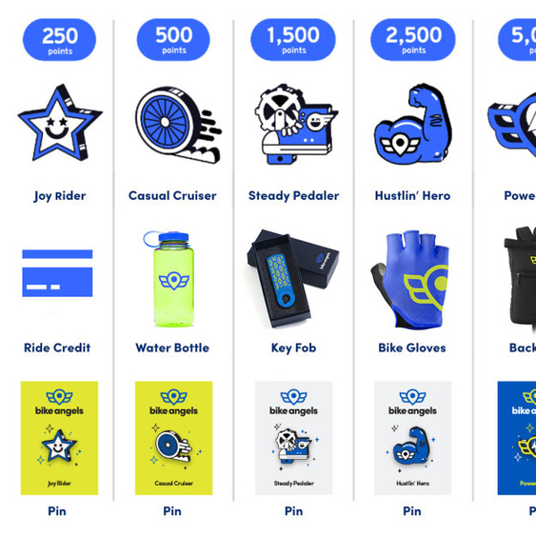
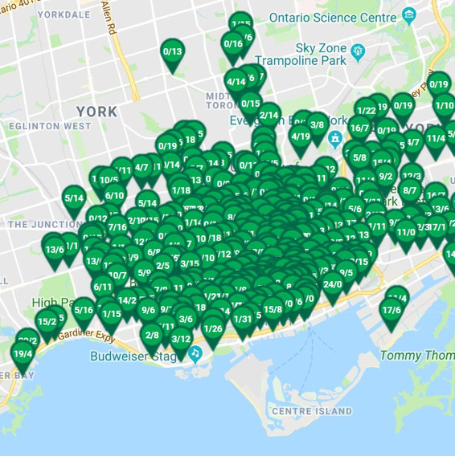
BIKE REDISTRIBUTION
Users are frustrated by bike unavailability and full stations, especially outside the downtown core.
Use data to expand redistribution efforts to underserved areas, particularly near transit hubs.
Bike Share's rebalancing efforts are too concentrated in the downtown area and in peak hours.
Create a user-incentive program, like NYC's Bike Angels, to reward riders for helping rebalance the network.

Slide 16
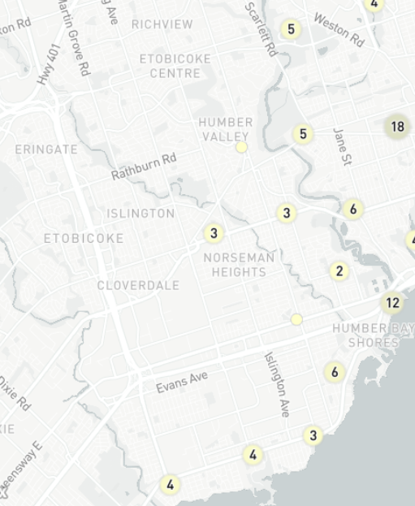
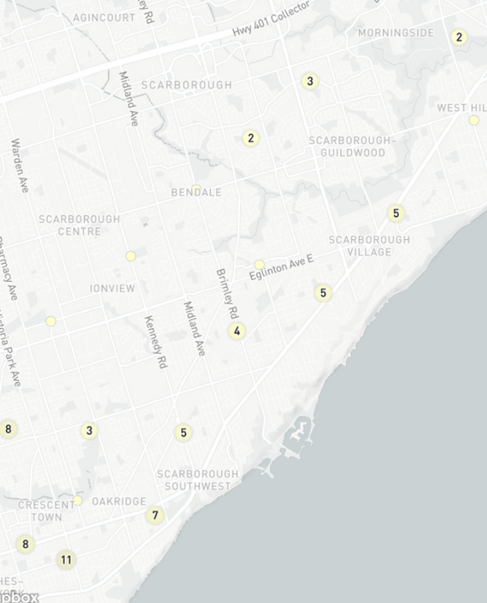
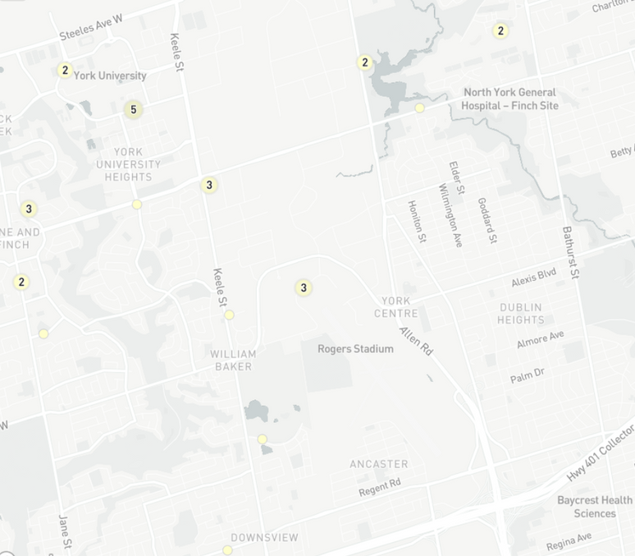
User feedback shows a strong demand for more bikes and stations in Etobicoke and North York.
Adding stations near schools, libraries, and grocery stores can reduce car dependence for short, local trips.
MORE
BIKES,
MORE
STATIONS
Key areas for expansion include transit hubs (Line 2, York U, the upcoming Line 5 and 6 LRT), major parks, and hospitals.

Slide 17
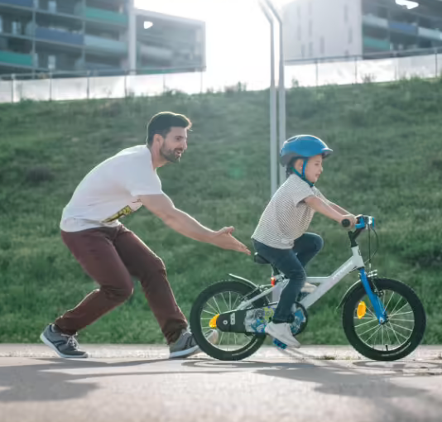
Our Challenges &
Lessons Learned
Integrating External Datasets
Matching Bike Share data with external sources like bike lane maps, weather, and demographics posed technical difficulties
Benchmarking with Other Cities
Lack of standard metrics across different cities made global comparison and benchmarking challenging
Multidisciplinary Thinking is Key
Combining data science, urban planning, and sustainability insights made the project more comprehensive and impactful

Slide 18
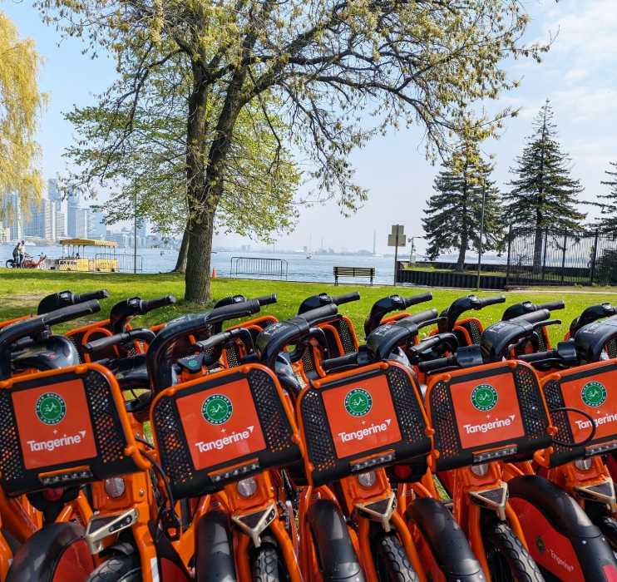

THANK YOU

